Slide 1

Medical Cost
Medical Cost Personal Datasets in the US

Slide 2
Executive Summary
The statistical examination of data distributions
The study of potential correlations between variables
The visual representation of relationships through the use of graphs
Prediction (ML)

Slide 3
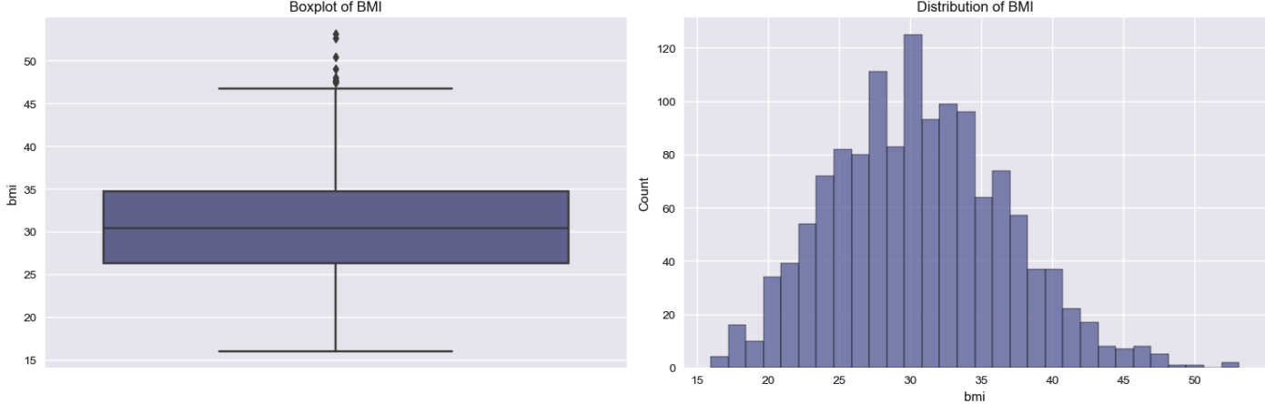
Results - Data Cleaning
Checking for Outliers and Data Distribution

Slide 4

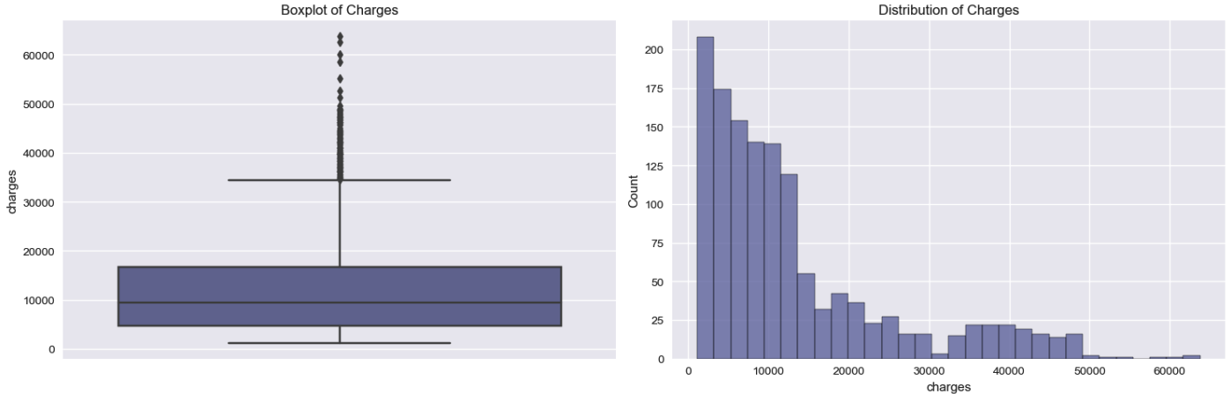
Results - Data Cleaning
Checking for Outliers and Data Distribution

Slide 5
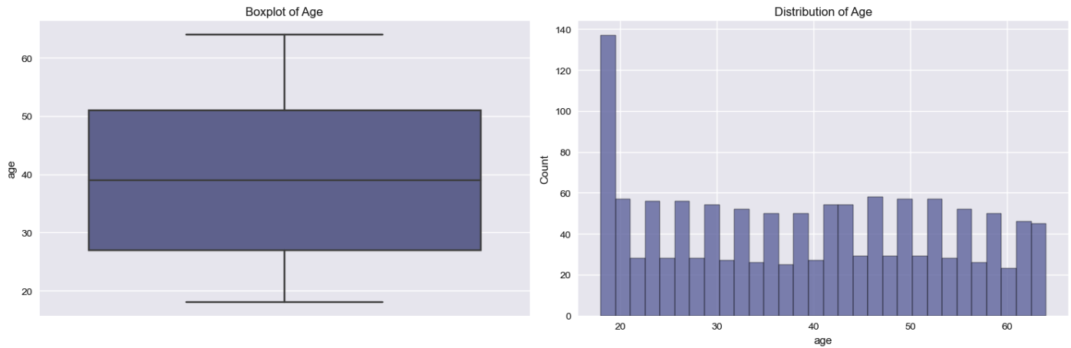
Results - Data Cleaning
Normal Distribution

Slide 6
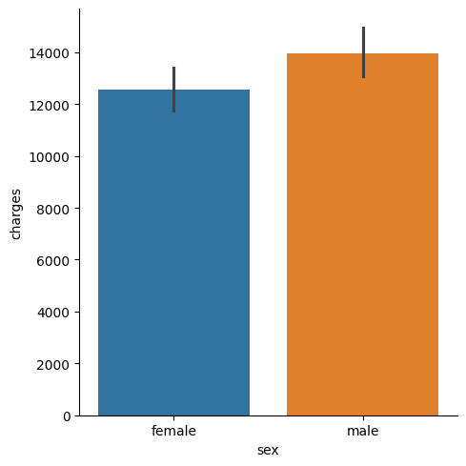
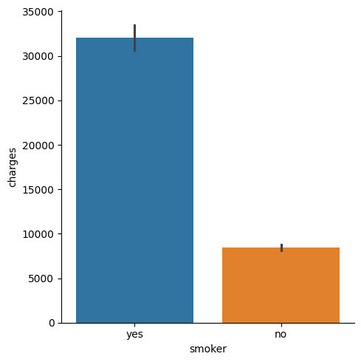
Results Analysis
Significant Variables : BMI / Smoker / Age.
Less-Significant Variables : Sex / Children / Region.

Slide 7
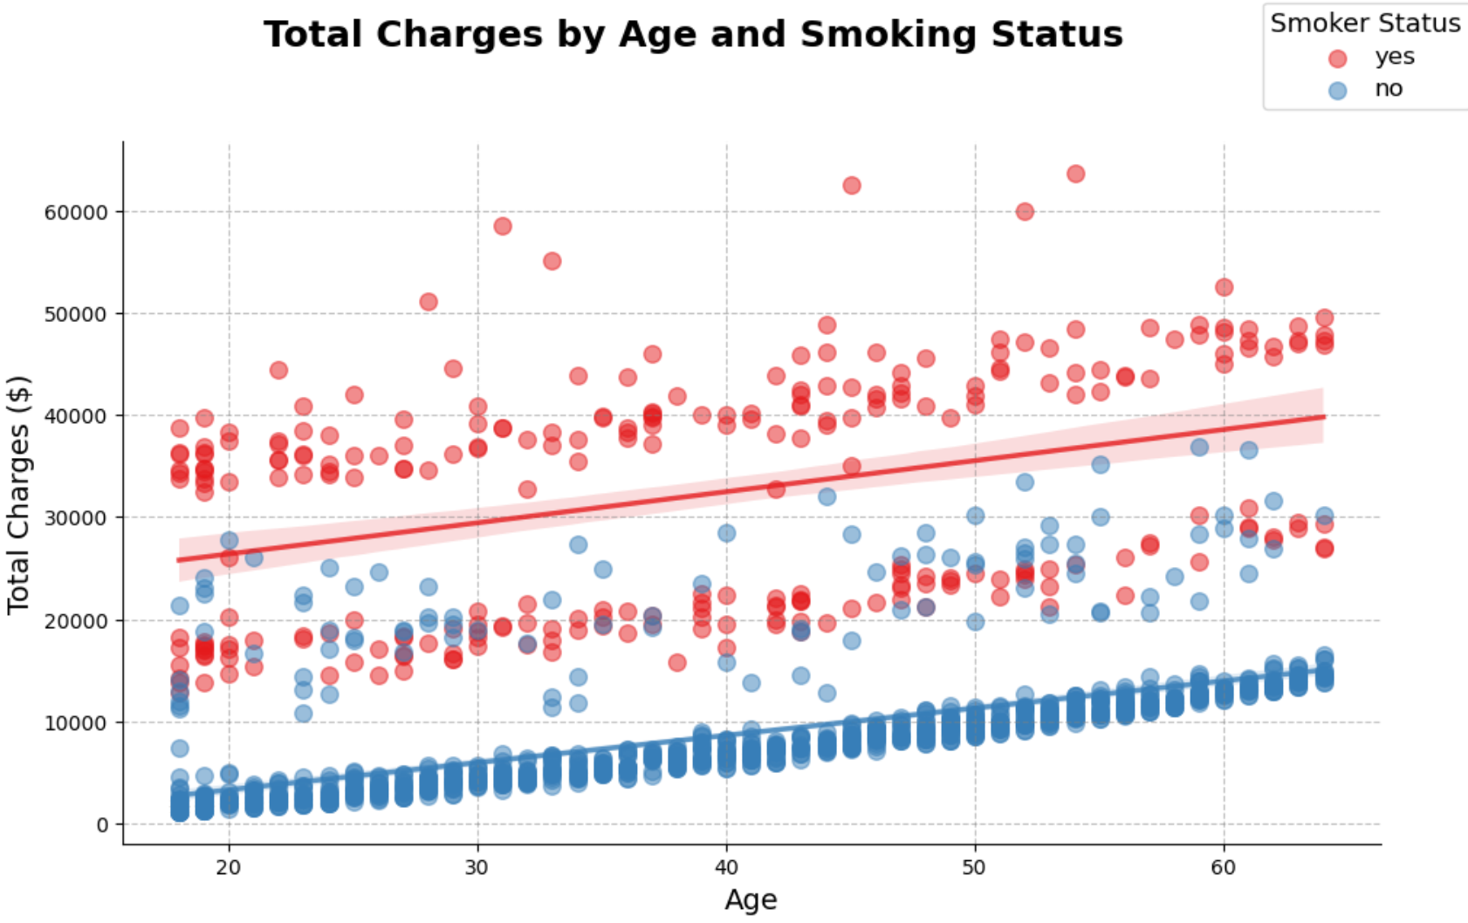
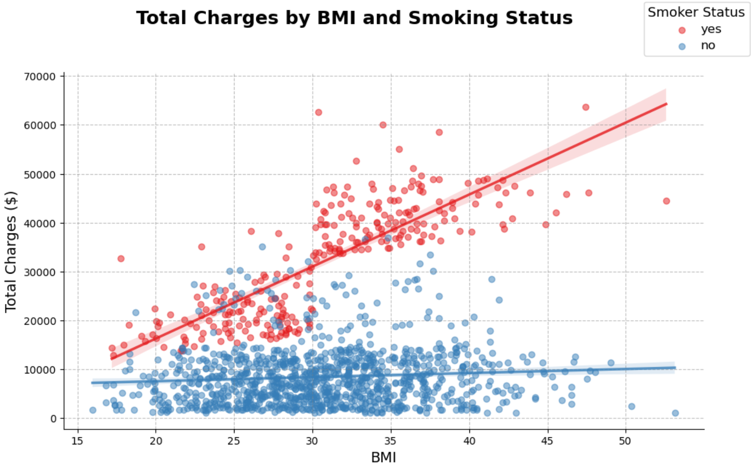
Results Analysis
Impact of Risk Factors on Insurance Premiums

Slide 8
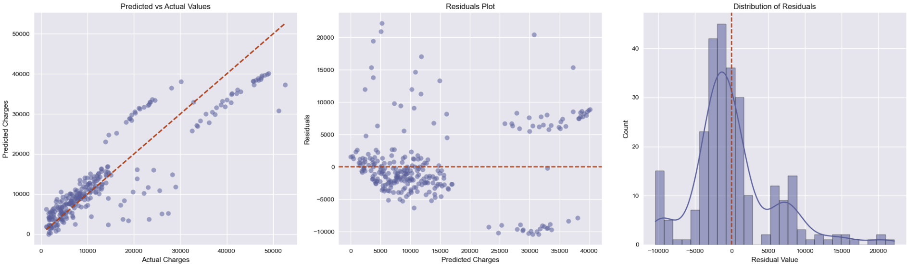
Solution description
Accuracy of Charges Predictions
With the full Data set we have an MAE of 4000 $.
With a selected Data set we have an MAE of 750 $.

Slide 9
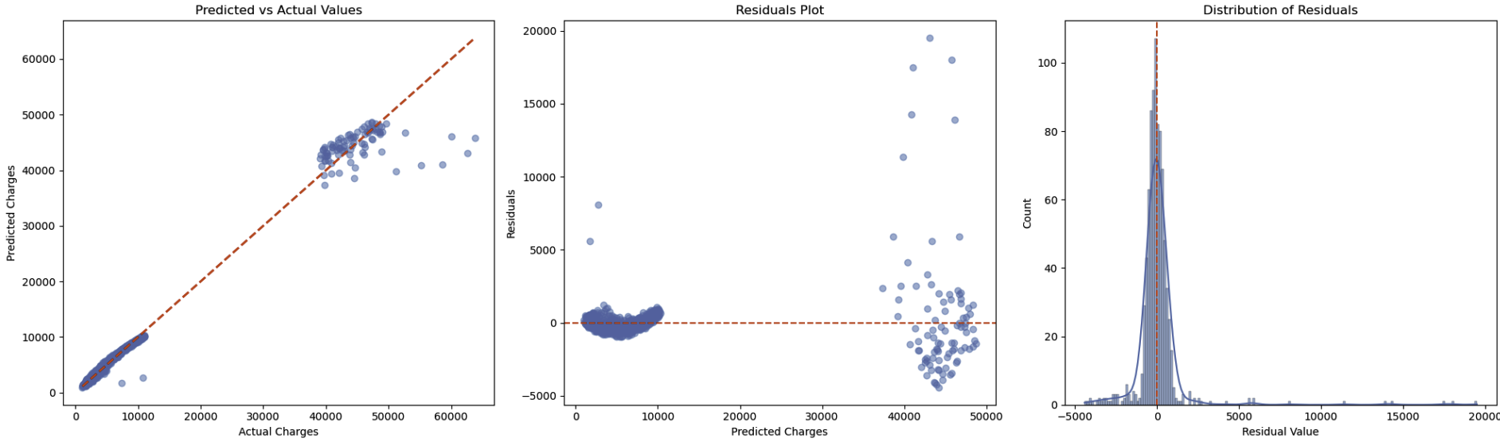
Solution description
Accuracy of Charges Predictions

Slide 10
Solution description
Accuracy of Charges Predictions
MAE of 4000 $
MAE of 750 $

Slide 11
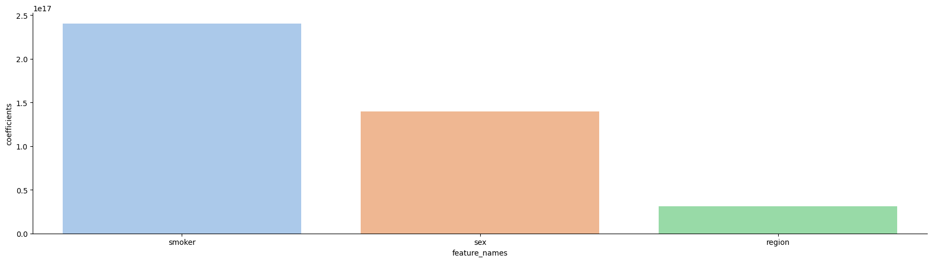
Solution description
Regression Model Coefficients
Categories feature importance:
Smoker are the most important as expected

Slide 12
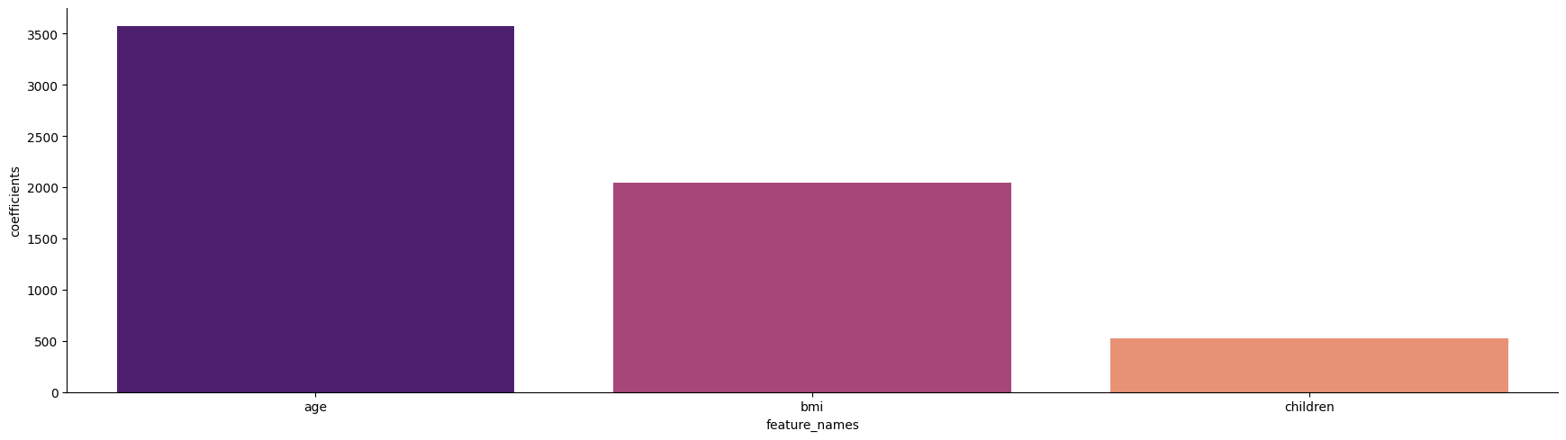
Solution description
Regression Model Coefficients
Numerical Categories feature importance:
age is the most important as expected

Slide 13
What’s next?
Other models to test :
Decision Tree Regression
Random Forest Regression
Support VectorRegression
KNN (K-Nearest Neighbors) Regression
Ridge Regression
Other variables to add :
Reasons of hospitalisation
Type of disease
Accidents

Slide 14


Any questions ?

